Slide 1


Topic Classification for SABC News Corpus using Supervised Machine Learning Methods
Mzwakhe Didishe
6 November 2024

Slide 2


Background and Objectives
Due to digitization, news outlets release significantly more articles
This creates a need to sort and organize news articles by topic
This project aims to address this problem by using machine learning methods to categorize the SABC News dataset
Three classifiers are developed:
Naïve Bayes
Logistic Regression
Random Forest
Compare results on labeled dataset and apply classifiers on unlabeled SABC News corpus

Slide 3
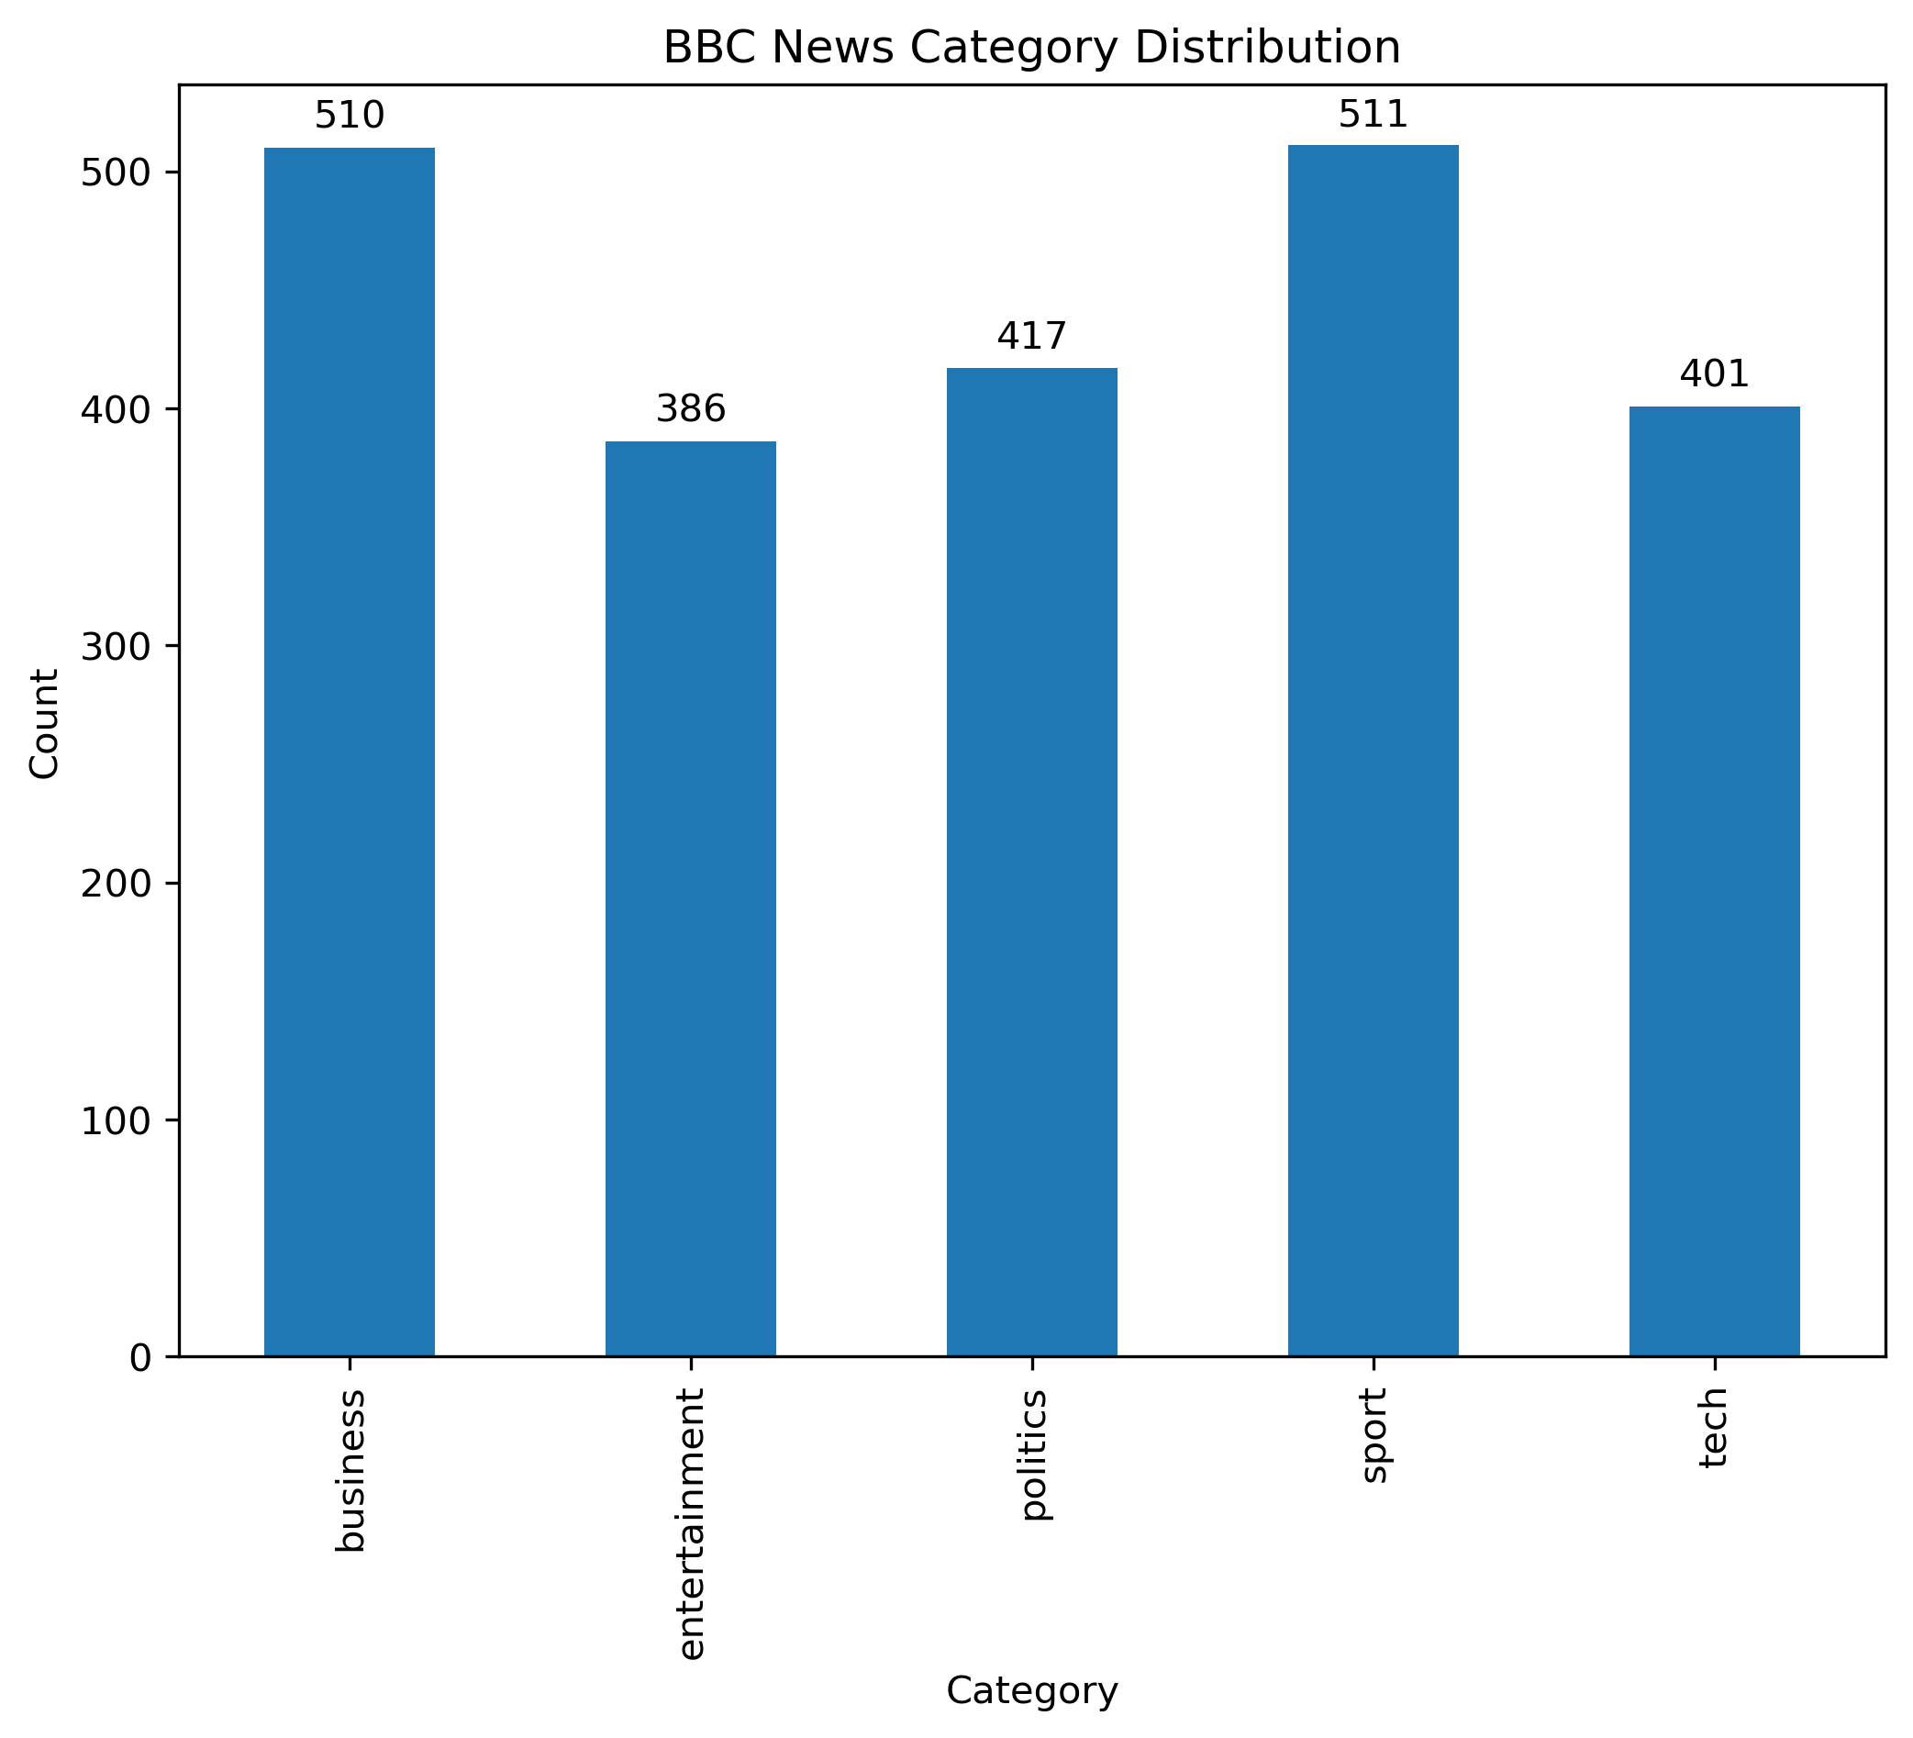
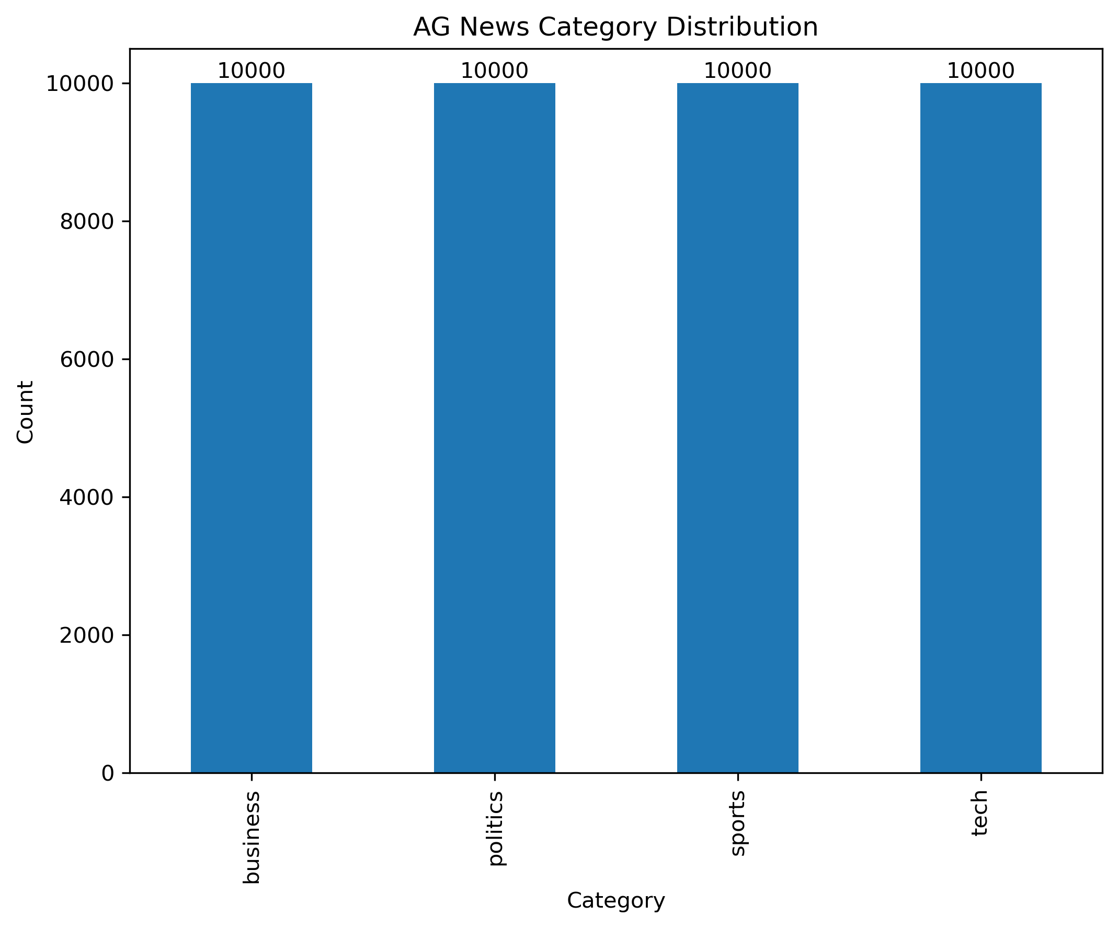
About the Datasets
5 Categories
2,225 observations
Fairly balanced
4 Categories
40,000 observations
Perfectly balanced

Slide 4
Approach
Data Preparation
- Remove columns
Text Representation
- Tokenization using CountVectorizor
- Use unigrams and bigrams
Develop classifiers
- Split data
- TF-IDF Transformation
- Train model - Evaluate performance
Categorize SABC News dataset
- Match AG News and BBC News labels
- Assess distribution of predictions
- Wordcloud visualization of frequent and important words

Slide 5
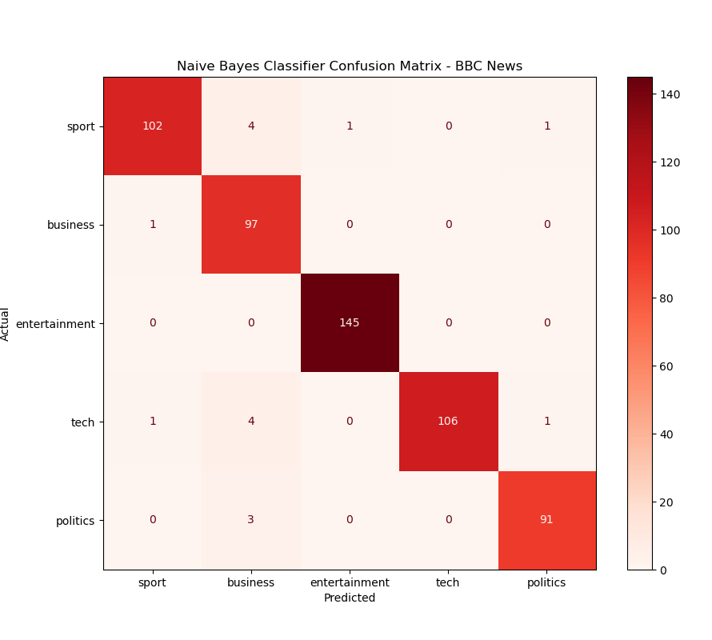
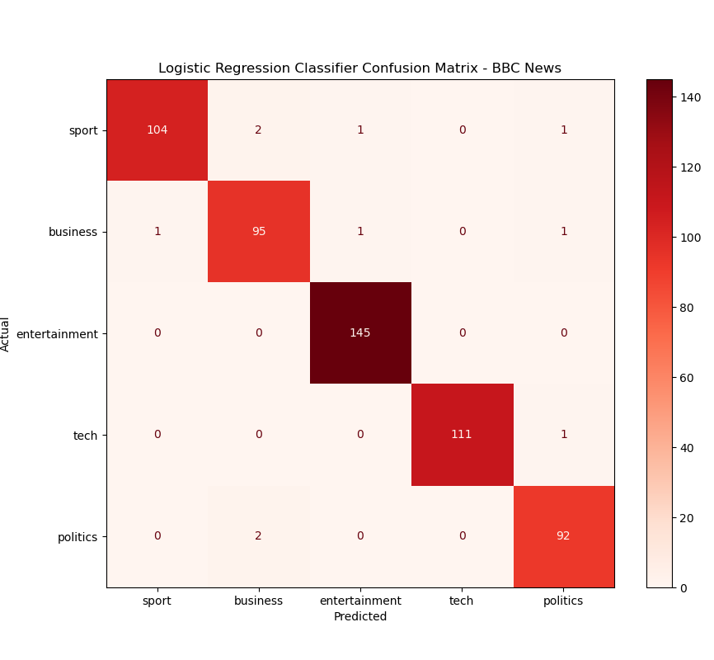
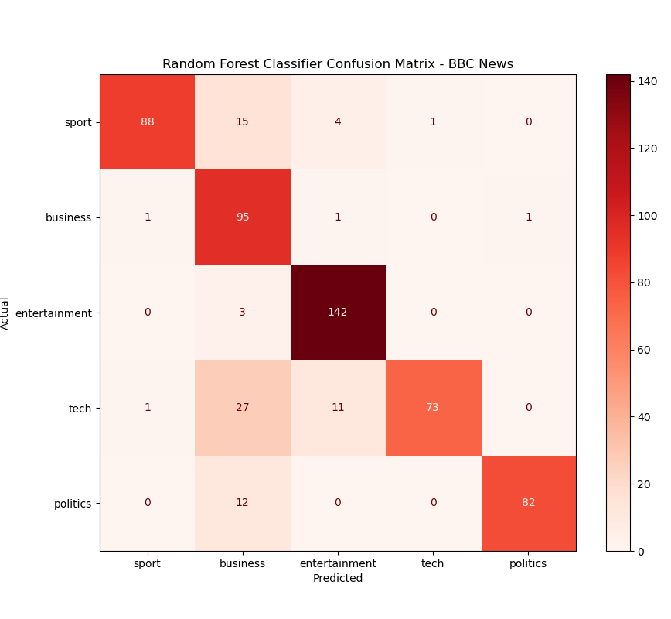
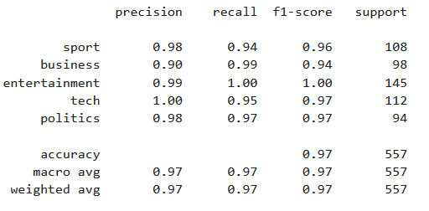
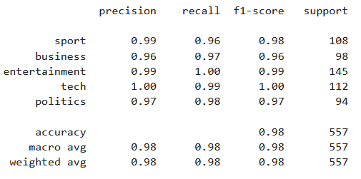
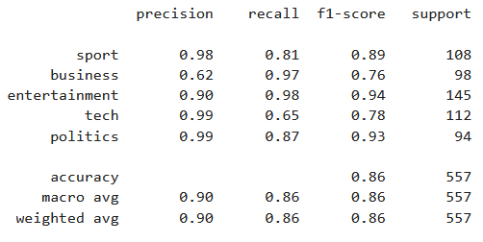
Results – BBC News

Slide 6
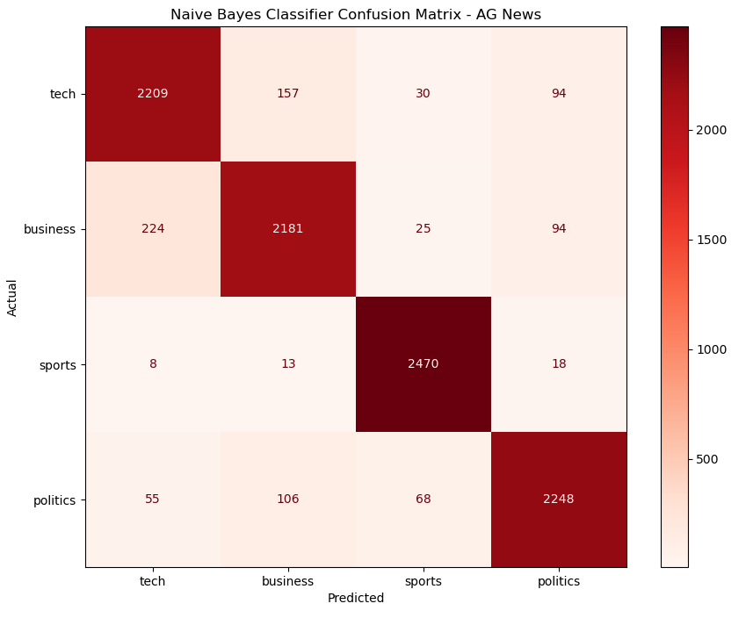
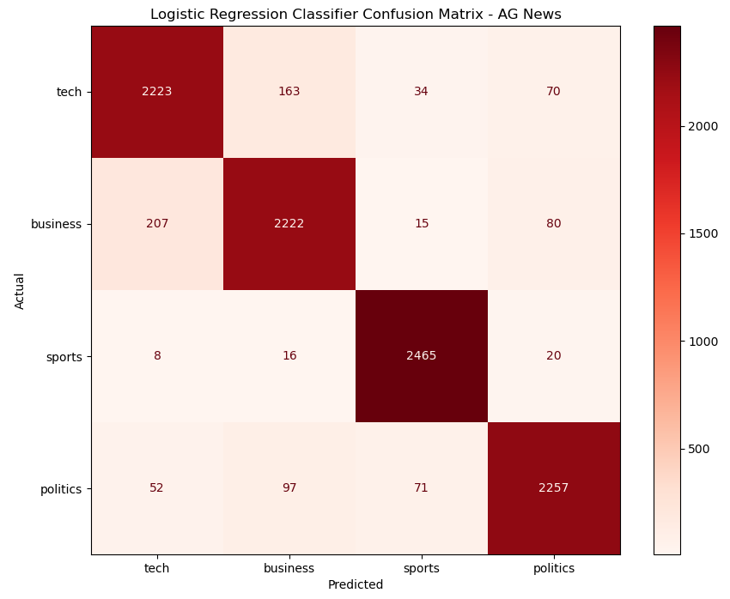
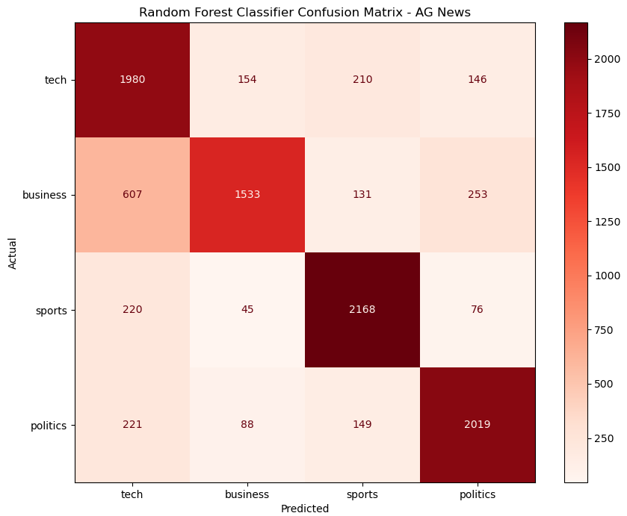
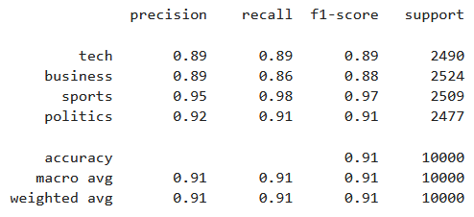
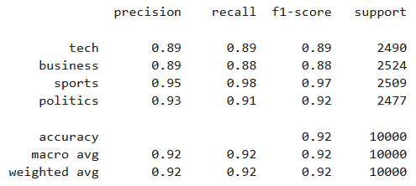
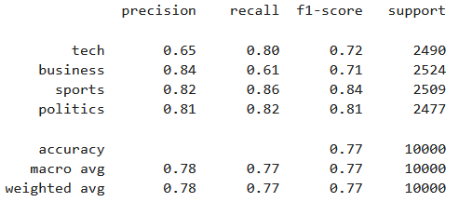
Results – AG News

Slide 7
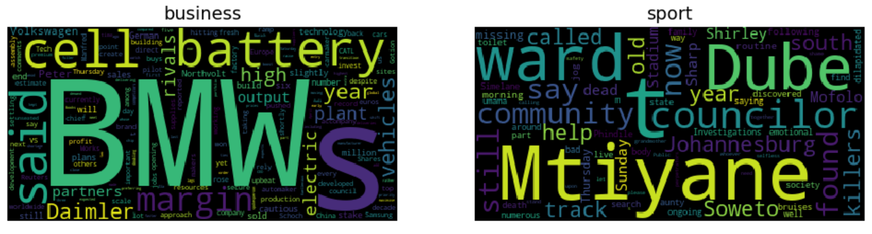
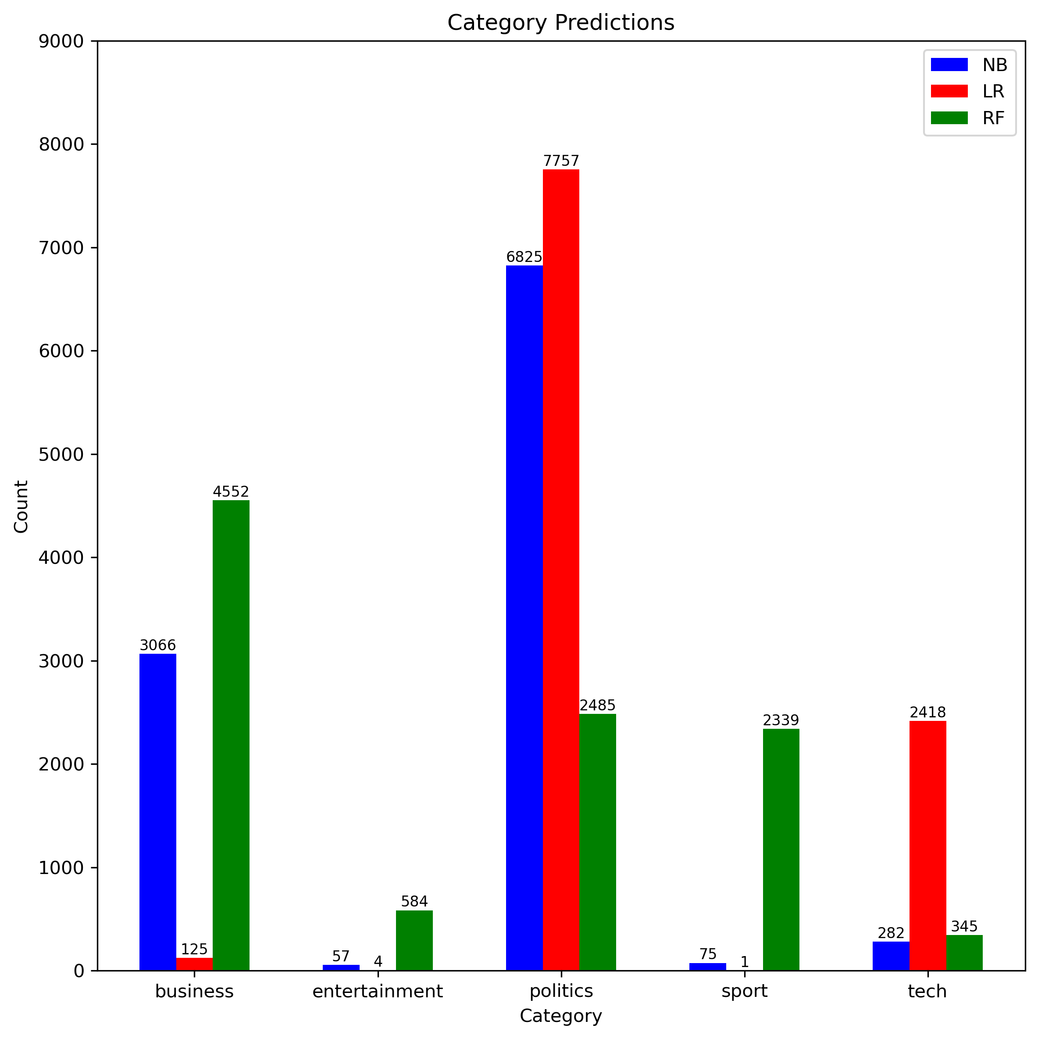
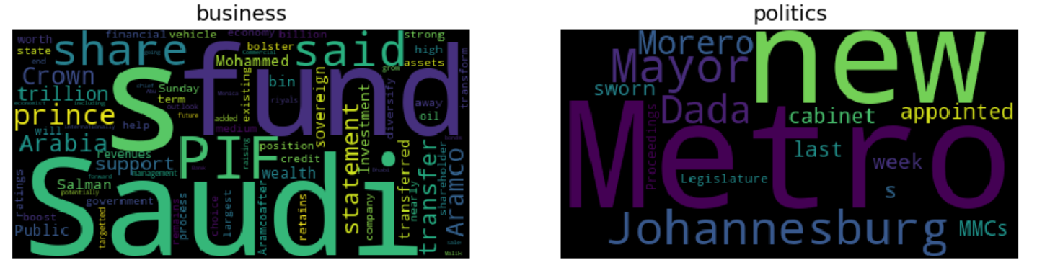
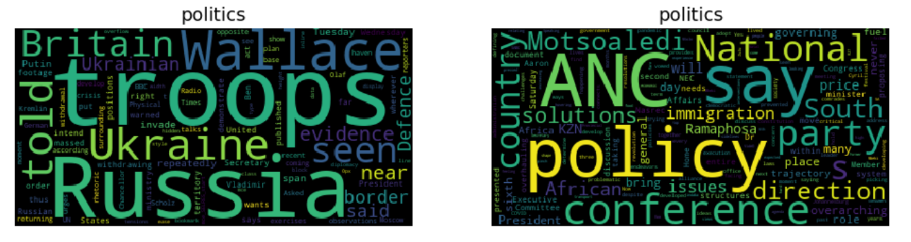
Results – SABC News

Slide 8
Conclusion
Politics and business are the dominant categories predicted
Very few entertainment predictions
Frequent and important words match categories
Future work
Explore transformer-based models
Compare supervised and unsupervised machine learning methods

Slide 9
THANK YOU

